Slide 1

Capstone Project
Airbnb Bookings Analysis
By
LAVANYA JILLELLA
LOKESH KUMAWAT

Slide 2
Points of Discussion :
About Dataset
Problems Statement
Data Exploration
Data Cleaning
Review on Host and neighbourhood
Review on Price distribution across neighbourhoods
Popular neighbourhood by Reviews
Preferred room type
Conclusion

Slide 3



What Is Airbnb?
Airbnb is an online marketplace that connects people who want to rent out their homes with people who are looking for accommodations in specific locales.
The company has come a long way since 2007, when its co-founders first came up with the idea to invite paying guests to sleep on an air mattress in their living room. According to Airbnb's latest data, it has in excess of 5.6 million listings, covering more than 100,000 cities and towns and 220-plus countries worldwide.
KEY TAKEAWAYS
Airbnb is an online marketplace that connects people who want to rent out their homes with people who are looking for accommodations in specific locales.
Airbnb offers people an easy, relatively stress-free way to earn some income from their property.

Slide 4
Problem Statement :
With the help of EDA will try to answer the following problem statements:
What can we learn about different hosts and areas?
What can we learn from predictions? (ex: locations, prices, reviews, etc)
Which hosts are the busiest and why?
Is there any noticeable difference of traffic among different areas and what could be the reason for it?

Slide 5
Feature Descriptions :
The feature in the dataset can be described as follows :
1.Id :This is the identity number of the property listed by the particular host.
2.Name : It stands for the name of the property listed by the host.
3.Host_id : It is the identity number of the host who has registered on Airbnb website.
4.Host_name : These are the names of the hosts who have listed their properties.
5.Neighbourhod_group :These are the names of the neighbourhood groups present in NYC.
6.Neighbourhood : These are the names of the neighbourhood present in the neighbourhood groups in NYC.
7.Latitute :These represent the coordinates of latitude of the property listed.
8.Longitute :These represent the coordinates of longitude of the property listed.
9.Room_type :This represents the various types of rooms listed by the host.
10.Price :This is the rent of the Property listed in USD.
11.Minimum_nights : This represents the minimum number of nights a customer rented the property.
12.Number_of _reviews : This represents the number of customers who reviewed the property.
13.Last_review :This represents the date when the property was last reviewed.
14.Review_per_month : It is the count of reviews per month which the property received.
15.Calculated_host_listing_count : it is the number of listings done by a particular host.
16.Availability_365 : This represents the number of days does the property is available among 365 days.

Slide 6
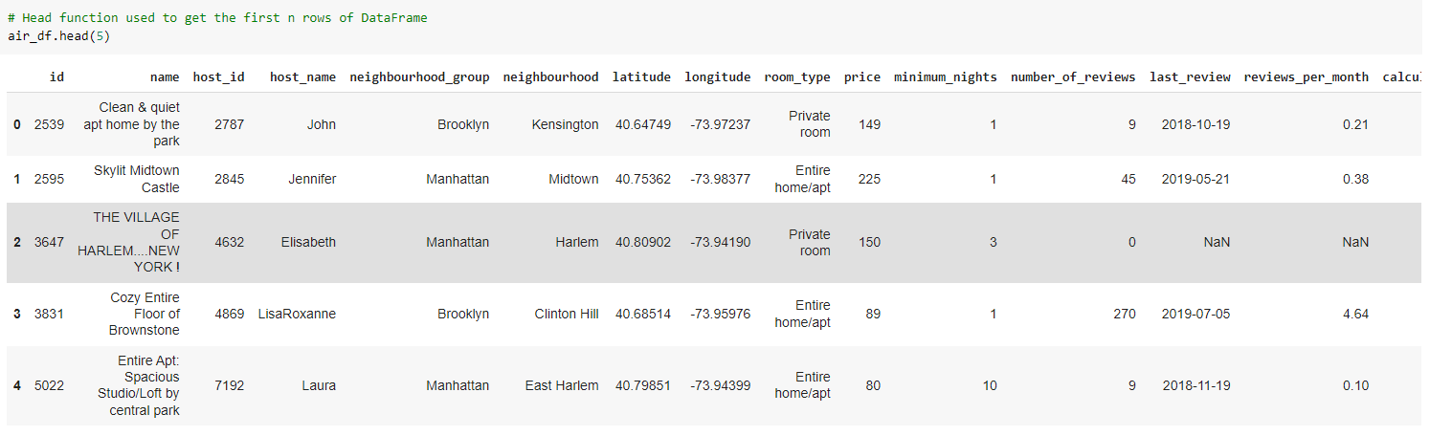
Data Exploration :-
We can see below first 5 rows of Dataset.

Slide 7
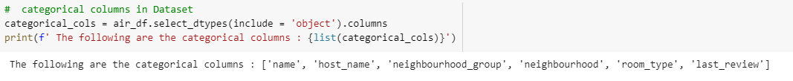
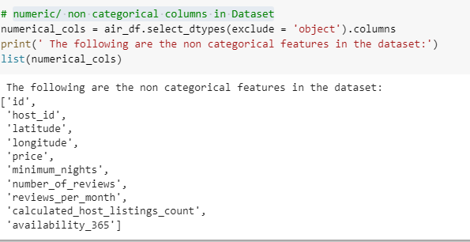
Categorical colmens in the Dataset:-
Numeric/ Non - Categorical columns in Dataset :-

Slide 8
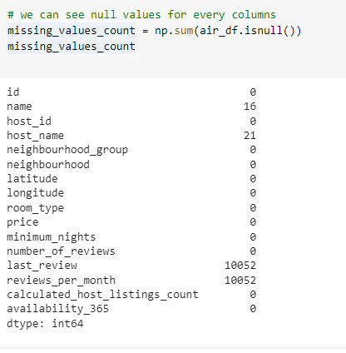
We can see null values in our Data set :
The columns ( last_review, reviews_per_month )
have the most of the null values.
The columns ( name, host_name ) have fewer null values.

Slide 9

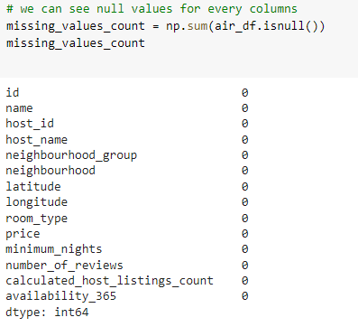
Data Cleaning :
We used ( fillna ) to fill fewer null values for the
columns ( name, host_name ).
We dropped the columns
( last_review, reviews_per_month )
have the most of the null values.
You can see we have no null values in our data set.

Slide 10
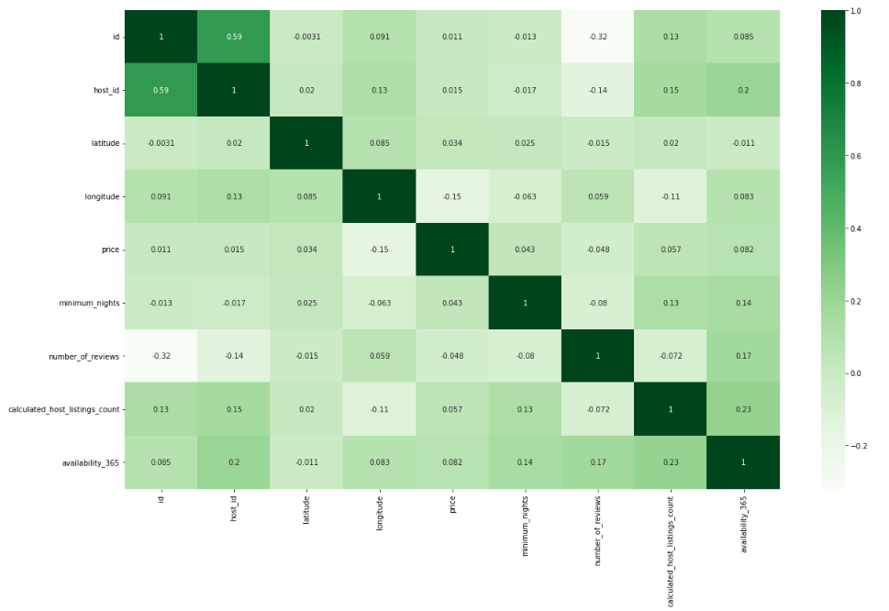
Viewing correlation of the numerical values

Slide 11
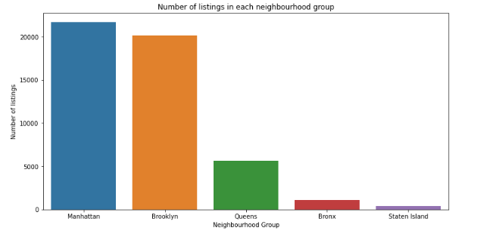
Number of listings across neighbourhood groups.
As we can see the Manhattan has
highest number of listings of 21661
which is 44.3% of total listings done
on Airbnb.
Brooklyn has 2nd highest number of
listings of 20104 which is 41.13% of
the total listings.
Queens comes in 3rd place with 5666
listings whereas Bronx and Staten island
have least number of listings.

Slide 12
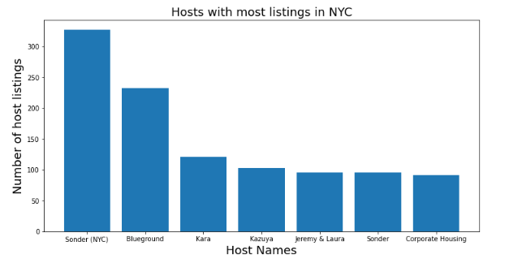
Hosts with maximum listings
We can see from chart there is a good
distribution among the top 6 hosts.
The host named Sonder ( NYC ) has
highest number of listings of 327 in
Manhattan neighbourhood group.
The host named Bluegorund has 2nd
highest listings of 232 in Manhattan
neighbourhood group.
The host Blueground also has 232
listings in Brooklyn.

Slide 13
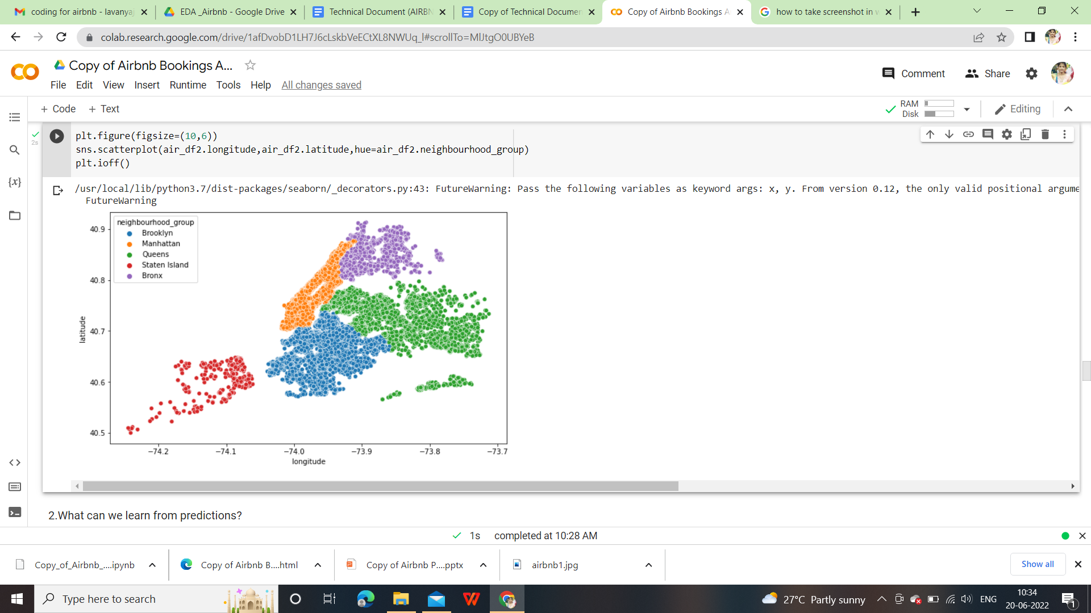
Hosts with neighbourhood group
Here we saw that which neighbourhood is preferred high chances of among five neighbourhoods.
Queens have the highest chances of neighbourhood.
Manhattan has the second highest rate of neighbourhood preferred by hosts.
Brooklyn has the third highest rate of neighbourhood preferrence.

Slide 14
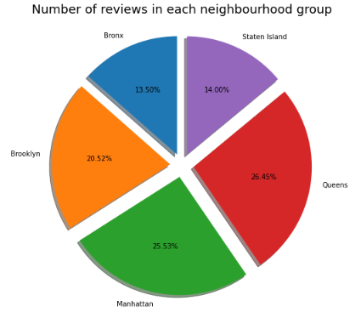
Areas with maximum reviews :
The number of reviews feature in the Dataset
represent the customers who have given the
reviews to a particular property they have stayed in.
Looking at the pie chart, Queens has 26.45 %
of total reviews which is a maximum share.
Manhattan has 2nd highest number of
reviews constituting 25.53%.
Bronx has 13.50% of total reviews.

Slide 15
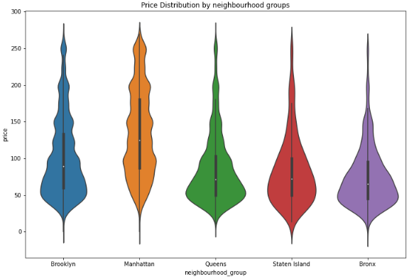
Price distribution across neighbourhood groups :
The adjacent violin plot represents the
price distribution across the
neighbourhood groups.
It is observed that, Manhattan has highest
price range and is it most expensive one.
Brooklyn comes in second which has higher
range of price but is cheaper with respect
to Manhattan.
Queens, Bronx and Staten island have
narrow price range and have cheaper
options.

Slide 16
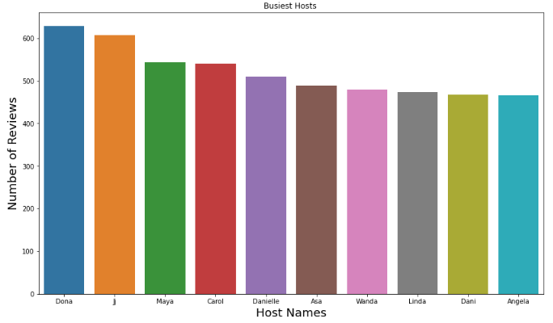
Busiest Hosts :
The adjacent bar plot shows the
top 10 hosts with respect
to number of reviews.
Among them Dona has highest number
of reviews and we can assume that
Dona is the busiest host.
The top host have listed private
room, entire home/apt.

Slide 17
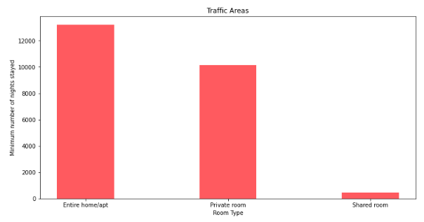
Most Preferred Room types :
Looking at the adjacent
histogram, we can say that
there are 3 room types listed
in the entire dataset namely
Private room, Entire home/apt,
shared room.
Among this type the most preferred
room type is Entire home/apt as
well as private room.
Shared room is least preferred by people.

Slide 18
Key Findings:
1. Manhattan has most number of listings, followed by Brooklyn and Queens.
Staten Island has least number of listings.
2. Manhattan and Brooklyn make up for 87% of listings available in NYC.
3. Brooklyn and Manhattan are most liked neighbourhood groups by people.
4. Queens has significantly less host listings than Manhattan. So, we should take enough steps to
encourage host listings in Queens.
5. The maximum demand is for private rooms and entire home/apartment. People are more
interested in cheaper rentals.

Slide 19
Conclusion:
1. The people who prefer to stay in Entire home or Apartment they are going to stay
bit longer in that particular Neighbourhood only.
2. The people who prefer to stay in Private room they won't stay longer as compared
to Home or Apartment.
3. Most people prefer to pay less price.
4. If there are more number of Reviews for particular Neighbourhood group that
means that place is a tourist place.
5. If people are not staying more then one night means they are travellers.

Slide 20

THANK YOU !
VISIT AGAIN!!

